Slide 1



AI & The company
Ecosystem
A Journey from "What is AI?" to Understanding the Future

Slide 2

"This morning, Sarah used AI 10 times before 9 AM...
without even knowing it."

Slide 3
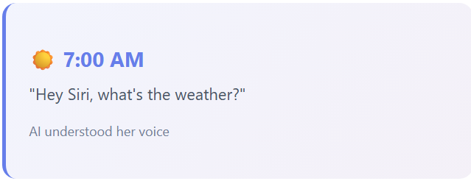
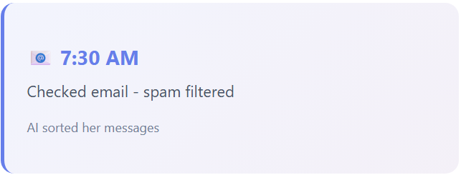
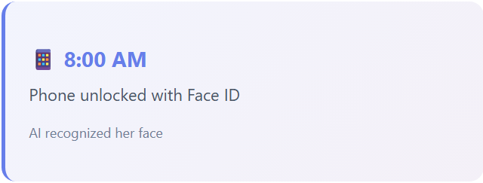
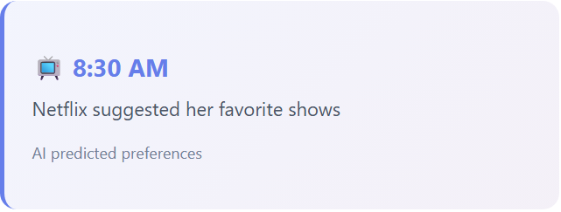


MEET SARAH
This morning, Sarah's day started like any other..

Slide 4

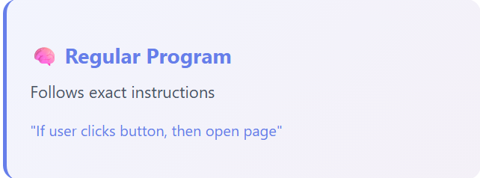
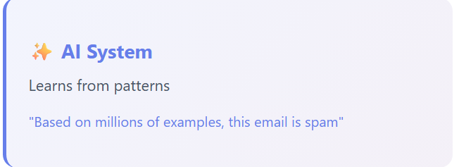

What is Artificial Intelligence?
AI is technology that makes computers do things that normally require human intelligence.

Slide 5
A Brief History on
AI
The Dream Begins
Term "Artificial Intelligence" coined in 1956. Early excitement: "Thinking machines in 10 years!" Reality: Computers too slow, not enough data.
1950s-1960s
1970s-1990s
The AI Winters
Progress slowed. Funding dried up. AI couldn't deliver on promises. Technology just wasn't ready yet.
Deep Learning Revolution
Breakthrough with neural networks. AlphaGo beats world champion. Image recognition becomes superhuman.
2010s
2022-Now
The Explosion
ChatGPT reaches 100M users in 2 months. Open-source platforms makes AI more accessible than ever. We're living through the revolution RIGHT NOW.

Slide 6



Why Now?
3 Game Changers
More Data:
2.5 quintillion bytes generated daily
Better Computers: GPUs process 1000x faster
New Techniques: Transformers & deep learning breakthroughs

Slide 7
Types of
AI
General AI (AGI)
Narrow AI
What exists today
• Google Translate
• Tesla Autopilot
• Face recognition
100% of current AI
Doesn't exist
• Can do ANY human task
• Purely theoretical
• Maybe 10-30 years?

Slide 8
The AI Hierarchy:
AI (Artificial Intelligence)
Machine Learning (Learns from data)
Deep Learning (Neural networks, multiple layers)
Generative AI (Creates text, images, video)

Slide 9


The Gartner
Hype Cycle
Every new technology follows this pattern:
1. Technology Trigger
Initial breakthrough generates excitement. For AI: rise of ChatGPT, generative models.
2. Peak of Inflated Expectations
Belief AI will solve everything. Wild projections about potential. Media hype.
3. Trough of Disillusionment
Reality sets in. High expectations not met. Many projects fail or stall.
4. Slope of Enlightenment
Practical implementations emerge. Understanding of strengths and limitations.
5. Plateau of Productivity
Mature adoption. Real, measurable benefits. Technology becomes standard.
We're currently between
stages 2 and 3

Slide 10
The AI Company Ecosystem
From chips to your apps - the value chain
Hardware (NVIDIA, AMD) - The Engine
Cloud (AWS, Azure, Google Cloud) - Infrastructure
Foundation Models (OpenAI, Anthropic, Google) - The Brains
Applications using API (ChatGPT, Midjourney) - What You Use
You - The User

Slide 11
Key Players in the
Ecosystem
Hardware: NVIDIA
Cloud: AWS/Azure/GCP
$3+ trillion valuation
H100 chip: $30K-40K each
Stock up 10x since 2022
Powers 90%+ of AI
AWS: 32% market share
Azure: 23% (Microsoft)
GCP: 10% (Google)
Training cost: $10M-$100M
OpenAI
Anthropic
$157 billion valuation
ChatGPT, GPT-5, DALL-E
Microsoft: $13B invested
100M users in 2 months
$30+ billion valuation
Claude AI (Sonnet 4.5)
Google + Amazon backed
Focus: AI safety

Slide 12



The Money &
Geography

Slide 13
But
...
⚠️ Geographic Flow of Money: A Global Issue
Concentration in the West: Most AI investment, research, and profits flow to US/Europe companies
Global South: Some countries investing in national AI programs (namely China and India), but far behind in resources
Resource Exploitation:
Cobalt & Coltan mining in Congo for chips/batteries
Kenyan workers paid $2/hour to label toxic content for ChatGPT
Not unique to AI - pattern across all tech industry

Slide 14


Slide 15
Key Challenges & Concerns
AI "Hallucinations"
AI confidently states false information. ChatGPT invented fake legal cases cited in real courts!
Bias in AI Systems
AI learns human biases from data. Resume screening discriminated against women. Facial recognition fails on darker skin tones.
Job Displacement
Some jobs replaced, others transformed. New jobs created (AI trainers, prompt engineers). Transition will be painful.
Energy Consumption
ChatGPT query uses 10x more energy than Google search. Significant environmental impact.
Privacy & Data Concerns
AI trained on data scraped from internet without consent. Artists/writers upset their work used without permission.

Slide 17
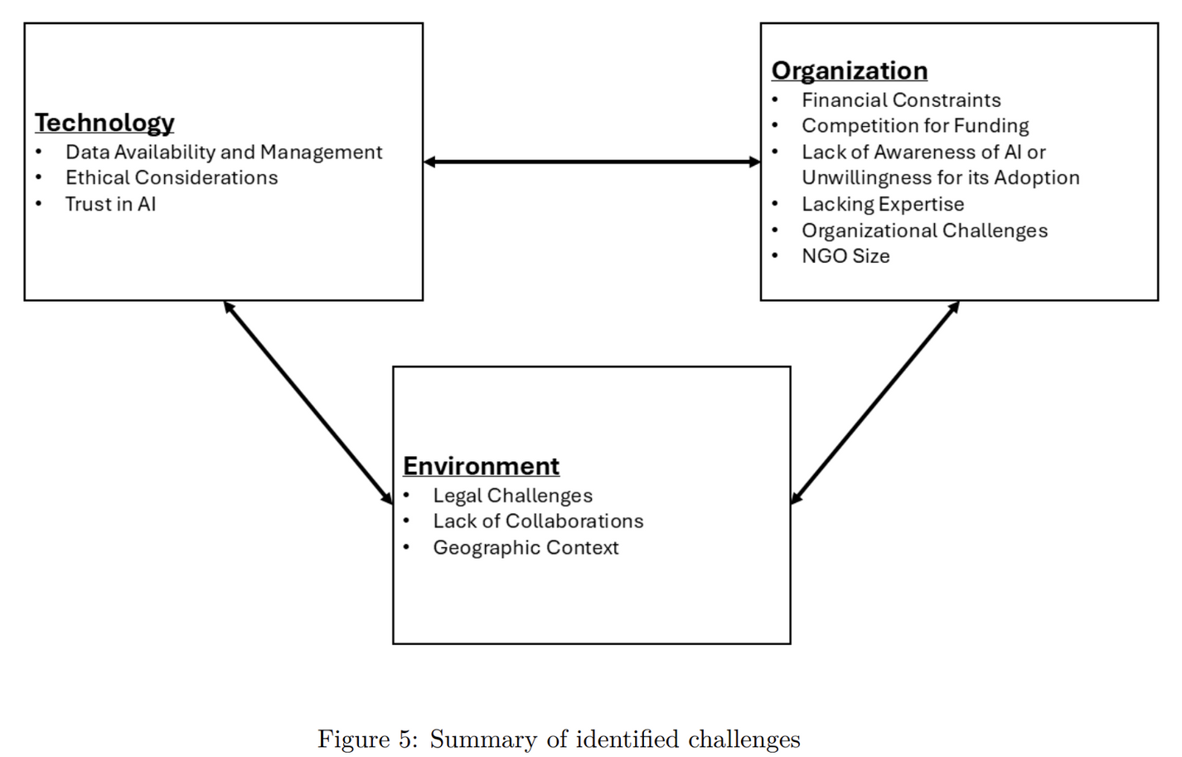
CHALLENGES FOR CBOs

Slide 18
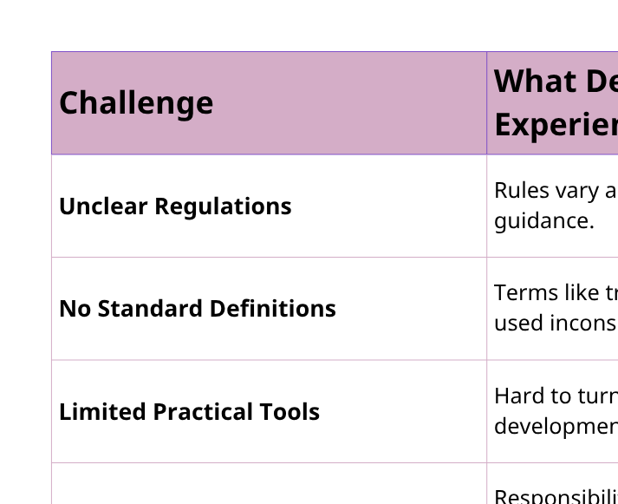
CHALLENGES FOR AI DEVELOPERS

Slide 19
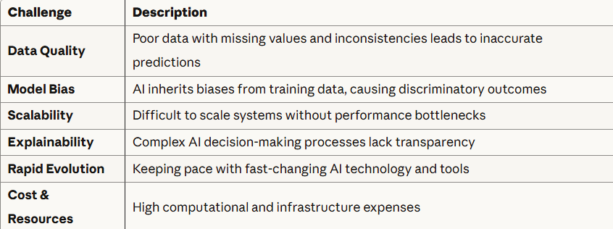
CHALLENGES FOR AI ENGINEERS

Slide 20
AI Regulations & Governance
Around the World
KEY STATISTICS
• 2,083+ AI governance initiatives worldwide (OECD)
• 21% increase in legislative mentions of "AI" in 2024
(9x increase since 2016)
• 700+ AI-related bills introduced in US in 2024
• 40+ new proposals in early 2025 alone
2025 MARKS THE SHIFT FROM PLANNING TO IMPLEMENTATION
IN AI GOVERNANCE WORLDWIDE

Slide 21
European Union - AI Act
Risk-Based Regulatory Framework
Timeline
Entered into force: August 1, 2024
Enforcement: Stages through 2025-2026
Risk Classification System
Unacceptable Risk → BANNED
High Risk → Strict Requirements
Limited Risk - transparency obligations
Minimal Risk → No Regulation
High-Risk AI Must Be:
• Safe & Transparent
• Traceable & Non-discriminatory
• Environmentally friendly
• Overseen by humans (not automation)

Slide 23
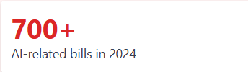

United States
State-Level Patchwork Approach
Key Challenge:
No single federal framework - patchwork of state laws creates complexity for businesses
Legislative Activity
Colorado AI Act (May 2024)
First comprehensive US state AI legislation
• Rules for developers and deployers
• Focus on algorithmic discrimination
• High-risk system requirements

Slide 24
China
Centralized State Control
Key Requirements
• Transparency: Label AI-generated content
• User Control: Opt-out of algorithmic recommendations
• Security: Strict data and security standards
• State Oversight: Centralized government control
Four Active AI Legislations
1. Interim Measures on Generative AI
2. Deep Synthesis Regulations
3. Algorithmic Recommendations
4. Ethical Measures

Slide 25
Around the world
Diverse Regulatory Approaches
Colombia
First country to adopt UNESCO’s Guidelines for AI Use in Judicial Systems, a framework designed to help judiciaries integrate AI while safeguarding ethics and human rights
No comprehensive AI laws or regulations yet
ASEAN - Guide to AI Governance and Ethics 2024
Non-binding and consensus-driven guidelines for governments and organisations to ensure AI businesses and users comply with existing national laws
South Korea - AI Basic Act to be enforced in 2026
The second comprehensive legislative framework in the world, focuses on national AI governance and mandates transparency obligations.
High-impact AI must implement risk management procedures and impact assessment

Slide 26

The Future (Next 5-10 Years)
AI Agents
"Book Italy vacation" → AI does everything autonomously
Personal AI
Knows your preferences, works 24/7
Healthcare AI
Personalized medicine, early detection
Science AI
Discover materials, drugs, solutions

Slide 27




Key Takeaways
AI is a Tool, Not Magic
Finds patterns in data. Has real capabilities and limitations. Understanding helps use it wisely.
We're in Early Days
Like internet in 1995. Most transformative applications not invented yet. You're witnessing a revolution!
Complex Global Ecosystem
Many specialized roles: chips → cloud → models → apps. Geographic inequality in benefits and costs.
Real Challenges Exist
Technology, organizational, and environmental challenges. Social justice issues around resource exploitation.

Slide 28
Remember Sarah?

Slide 29
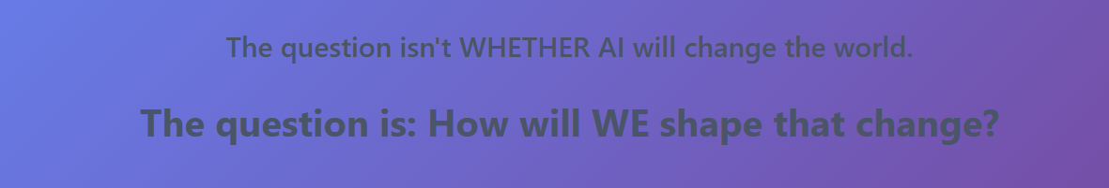
She now understands that when Siri answered her, it was using natural language processing. When Netflix made recommendations, it was machine learning analyzing millions of patterns. When her Face ID worked, it was deep learning neural networks.
She's living through a fundamental shift in human history!.
Sarah now asks better questions:
Not "What is AI?" but "How should we use AI?"
Not "Will AI take my job?" but "How can I work with AI?"
Not "Who controls AI?" but "How do we ensure AI benefits everyone?"

Slide 30
The AI story is being written now. We are part of it.

