Slide 1


How can frugal innovation become inclusive innovation
Mobile payments in Kenya:
is M-pesa a frugal innovation?
￼
Lukas Wellen, Meine Pieter van Dijk

Slide 2
1. Financial sector
Financial inclusion is considered important for economic progress and poverty reduction (Simanowitz 2001, Ledgerwood 2006)
The majority of the poor remain unbanked and many MSMEs lack access to affordable financial services
Such clients are targeted by frugal innovations, including new financial services and delivery mechanisms (Agarwal 2015, Herstatt/Tiwari 2012)
M-pesa is considered a showcase frugal innovation (Stanford, Wikipedia) as it is oriented at disempowered clients (poor, remote, uneducated people)

Slide 3
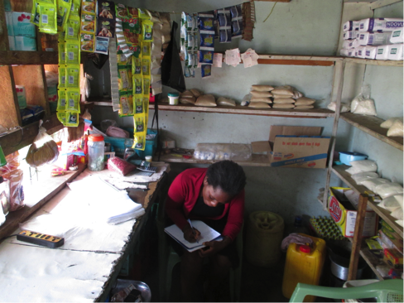
2. M-pesa/Safaricom background
Mobile cash-in/out transactions are performed by 89,000 agents (of which only 10% are controlled by Safaricom)
M-pesa is a mobile payment monopoly. Issues: Platform has to be adapted per phone type Know Your Customer-law is difficult to follow in remote areas Lurking competition Investors focus on profitability
Disempowered clients are (therefore) more difficult to reach

Slide 4
3. Research in Kenya (2015/9)
Goal: assess if M-pesa is a frugal innovation, provider of financial services to disempowered people
Research: how Safaricom understands and interacts with disempowered clients
Approach: qualitative semi-structured discussions with eight Safaricom seniors, three field staff, seven agents and 11 clients, plus ethnographies by TNS
Focus on clients’ worries & wants, trust & networks and gaps in their experience journey (Mullainathan/Shafir 2013, McGaffey 2014, Ravi/Tyler 2012)
“Checklist”: operational issues for frugal mobile payments

Slide 5
4a. Operationalising a frugal innovation
Element | In the case of M-pesa take into account that:
1. Segmentation | Disempowered people are a separate market segment
2. Service development | Listen to clients and differentiate services for disempowered people (simplified products)
3. Client contact | Disempowered people need adapted client contact (more oral information, several contact moments)
4. Language | Adapt communication to the understanding of the clientele
5. Social networks | Networks are important sources of information for disempowered people (for trust and understanding)
6. Feedback | Client feedback helps adapting services to the needs of disempowered people (learning by doing takes time)
7. Adapt service delivery | Disempowered clients need adapted service delivery (more time, more explanation)

Slide 6
4b. Results: understanding clients
Element | Findings at M-pesa/Safaricom
Segmentation: standard business tool to understand clients (Collica 2011) | M-pesa has 21m clients, divided in only 4 generic segments based on turnover (plans to build 16 less generic segments, still mainly based on turnover; plans to perform ethnographies for high turnover clients)
Agents: key for contact, especially for disempowered clients that sometimes even have to be explained the use of phones (Ledgerwood 2006, Mehta/Realini 2015, Grameen 2013 ) | Yet, Safaricom considers agents as transaction generators, not as client contacts Focus on the superagents that generate 80% of turnover, not on remote agents
Language: adapt per segment to be understood (Economidou 2011) | Yet, Safaricom uses written mid-level English/Swahili: difficult for disempowered clients

Slide 7
4c. Results: understanding clients
Element | Findings at M-pesa/Safaricom
Social networks are important (Ledgerwood 2006, Hospes/Lont 2004) | Yet, clients are considered as individuals, not in their social context
Listening to clients is key to understand them (Robinson 2002, Thompson 2013, Cohen 2009) | Safaricom listens to clients through its Call Centre, but focuses on solving issues, not on understanding clients There are only urban Field Centres, not in remote parts
Following client satisfaction helps getting feedback (Wilburn 2007, Chapleau 2013) | Focus on the general Net Promoter Score, not on satisfaction with agents, nor the client retention rate High Promoter Score is almost a given for a monopoly

Slide 8
4d. Results: building services
Element | Findings at M-pesa/Safaricom
Breakthrough services do not require client input as they lack a reference frame (Alexander/Hordes 2003) | Safaricom uses engineer-driven product development: create services in-house; rollout; updates to correct malfunctioning
Mature products should include client understanding and testing by clients (Harvard Business Review) | Safaricom plans to include client-understanding in product-development
Differentiate product/communication/price to reflect level of understanding | Yet, the same service is offered to all clients, although high-turnover clients get preferential Call Centre treatment
Agents have the market-knowledge and handle most contacts between clients and Safaricom | Yet, agent insights are not used for product development
The Call Centre is the main client contact for Safaricom (>100k calls per week) | Yet, no contact satisfaction follow-up Clients complain about delays and service

Slide 9
4e. Result: building services
Element | Findings at M-pesa/Safaricom
Agents: key for clients, especially disempowered people need explanation and time to understand services (Lal/Sachdev 2015, Ledgerwood 2006) | Yet, there are only financial requirements to be an agent. This low-condition increases the number of agents, but decreases service quality (Mas/Ngweno 2010) Agents are not suspended for weak service, only if they are reported (rarely) for fraud
Business-sector propagates the improve-services approach (Total Quality Management, 6-Sigma) to “achieve total client satisfaction” | Instead, focus on reducing the number of Client Care Calls and on solving issues (requiring an understanding of the system), not on improving-services (requiring insight in clients)
Simplicity is key for frugal innovations (Agarwal 2015) | Services do not “pass the simplicity test” as developers focus on developing products, instead of building client-oriented solutions Even the M-pesa fee structure is considered complicated (agents, Business Science 2015)

Slide 10
5a. In summary
Element | Situation at M-pesa/Safaricom
1. Segmentation | Only generic market segmentation based on turnover (planning to introduce client characteristics)
2. Service development | Services are created in-house; rolled-out; updated to correct malfunctioning (planning to include client feedback, but not agent feedback) Client-trust is not part of Safaricom’s agent management and agents are not trained in client service/trust-building Mobile Payment Operators focus on reaching economies-of-scale through technology, marketing and distribution
3. Client contact | Safaricom listens to clients through its Call Centre to solve issues, not to understand clients Field Centres are in urban areas, not in remote parts Difficult to reach the Call Centre (focus on high turnover clients)
4. Language | Uses written mid-level English/Swahili; difficult for disempowered clients
5. Networks | Clients are considered as individuals, not in their social context
6. Feedback | Focus on the general Net Promoter Score, not on satisfaction with agents or retention rate High Promoter Score is almost a given for a monopoly Safaricom does not analyse feedback per segment and focuses on solving-issues, not on improving-services
7. Adapt service delivery | Safaricom offers the same services to all clients For disempowered people the gap in the experience journey begins at the start: lack of understanding how to activate and use the service

Slide 11
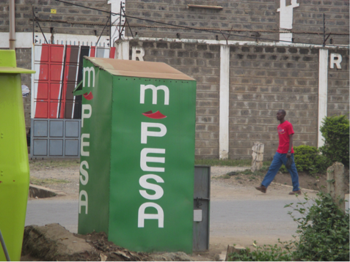
5b. Conclusion
It is questionable if M-pesa is actually a frugal innovation as Safaricom is focused on technology and high-turnover clients and has not built approaches (listening, understanding, feedback, adapted services) to handle “the hard to reach” disempowered clients

Slide 12
6. Suggestions to become more frugal
Understand clients through segmentation, group characteristics, feedback per segment
Segmentation: include understanding of language/literacy/numeracy skills, adapt communication and services accordingly
Client/agents: use them for feedback and product development
The Call Centre is a major contact channel so follow user satisfaction
Remote clients: have Client Centres in remote areas and train agents to deal with disempowered clients
Client satisfaction: follow feedback per agent and remove them when they score low, also check if KYC is followed to diminish fraud
Agent network: maximising the network is against the interest of clients and agents (lower service level)
Performance ratios: instead of focusing on the general Net Promoter Score, differentiate between segments and add qualitative opinions
Product improvement: focus on improving services, not on solving issues

Slide 13



