Slide 1
Frugal Innovation: A Case of food processing industries in Manipur, India
Wairokpam Premi Devi and Hemant Kumar
Centre for Studies in Science, Technology and Innovation Policy
School of Social Sciences, Central University of Gujarat
India-382030

Slide 2
Presentation plan
Introduction
Theoretical framework- Frugal Innovation and Actor Network Theory
Methodology
Background of case study
Case analysis
Conclusion

Slide 3
Introduction
Indian food processing industry- as a 'sunrise industry' and as ‘priority’ sector (Sinha and Sinha 1992).
The establishment of food industries has led to the development of many new ideas and knowledge that favorably facilities the innovation process in the industries.
Thus, innovation is seen as a clear and explicit way for entrepreneurs to increase competitiveness and create wealth as they respond to the demands and opportunities of a globalizing economy (Porter, 1990).
Consequently, the “need for innovation” fever appears in all spheres of science (Nowotny, 2006, 2008; Godin, 2008).

Slide 4
Driven by the scarce resource and low-income level of consumers, many innovators now resort to low cost, local centric idea called as frugal innovation.
Manipur has certain geo-economic disadvantages; situated at the extreme corner of India, difficult terrain (resulting in transport issues) and frequent blockades on roads besides acute shortage in logistic infrastructure. Inspite of varied obstacles, there are forward thinkers and innovators who brought creative solution within its own limitation.
Thus the paper makes an attempt to understand the process of frugal innovation and how it can be characterised by the involvement of various actors of diverse background.

Slide 5
Review of literature: Frugal innovations and actor network theory
Frugal innovation -recently developed concept in the study of innovation system and developed under the conditions of resource constraints.
Derived from the term ‘frugal engineering’ coined by the CEO of Renault – Nissan, Carlos Ghosn (Agnihotri, 2014).
Bound and Thornton (2012)- gives four features of frugal innovations:
  Frugality in making better things and not just cheaper things
  Frugal innovations also extends to services and not just products
  Frugal innovations involve remodelling of products
  Frugal innovations are not low tech rather can be combined with frontier S&T

Slide 6
Frugal innovations are the result of the recent ambitions of mostly Multinational Enterprises (MNEs) to design and sell products for and to consumers at the Bottom of the Pyramid (BoP) (Beers et.al, 2013).
Prahlad (2010) first introduced the term BoP and argues that the poor are potential consumers.
Nakata & Weidner (2012) mention three reasons for this trend.
  BoP and the rising middle classes represent the most significant remaining, or unaddressed, global market.
  Second, the people at the BoP do, in fact, have financial resources, representing about five trillion US dollars in purchasing power parity, according to estimates by the World Resources Institute (2007).
  Third, the BoP and emerging middle classes are receptive and willing to spend money on quality products, provided these are suitable, well made and reasonably priced (Beers et.al, 2013).

Slide 7
Actor Network Theory
Work of - Michel Callon (e.g. 1986), Bruno Latour (e.g. 1987), and John Law (e.g. 1987).
“tracing the ‘world building activities’ making up the social and material relations that surround us in a way that unravels what we normally take for granted” ___Latour & Law (1999, 2004)
Methodological principles of ANT
  generalised symmetry
    no distinction between human and non-human actors
  agnosticism
    suggests that the observer of the actor network, needs to be impartial, and requires that all interpretations be unprivileged.
  free association
    abandonment of all a priori relationships that could be assumed to exist between human and non-human actors

Slide 8
The core concept- Translation
“Translation is a process of creating a temporary social order, or the movement from one order to another, through changes in the alignment of interests in a network” ___Callon (1986)
Four Stage of translation
  problematization
  answers the question of how to become indispensable
  Interessement
  answers how the allies are locked into place
  Enrollment
  answers the question of how to define and coordinate the roles

Slide 9
    Mobilization
    answers the question, do the delegate actors in the network adequately represent the masses
According to ANT, innovation and its conceptualisation should not be viewed as rationally predictable achievements, but rather as a fluid and erratic translation.
In this context, we will look into bamboo shoot processing in Manipur.

Slide 10
Research question
  What is the process of frugal innovations in bamboo shoot processing in Manipur?
    In particular, how agency (programmes of action) is produced and confined, and how actors are enlisted into stabilising sets of relationships in the process of innovation?
    And, how is agency in humans and non-humans manifested in these relations?

Slide 11
Methodology
Ethnography
Traditional Bamboo processing areas (participant observation, informal interviews)
Food Processing Industry (in depth interviews and questionnaire with workers, proprietor and observation)
Market places/ customer (informal as well as formal interviews)
Food technologist, (Formal interviews)

Slide 12
Background of case study
Bamboo Shoot (Soibum), as a traditional food of Manipur, evolved thousands of years ago, still indispensable for majority of people.
But the shelf life of freshly harvested bamboo shoots is 9 and 23 days in water and brine, respectively (National Mission for Bamboo Applications, India 2009).
Need of fermentation arises.
The practitioners have been practising the lactic fermentation process to preserve the perishable and seasonal vegetable in absence of refrigerator and freezing.
They gain knowledge and wisdom through experiment and based on trial and error.

Slide 13
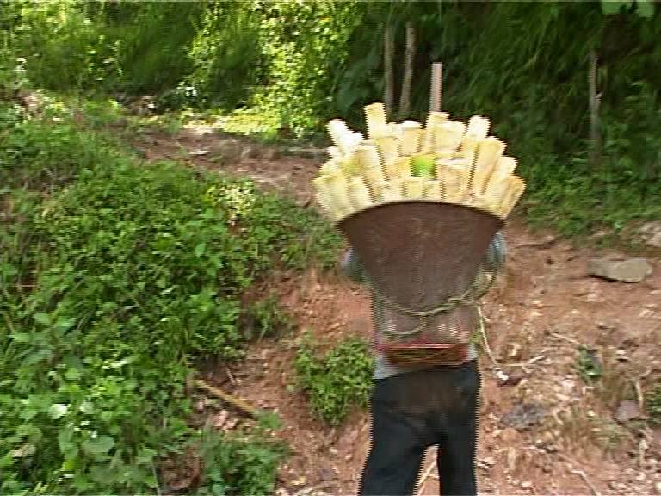
succulent bamboo shoots are collected from nearby hills of bamboo forest

Slide 14


Bamboo forest

Slide 15

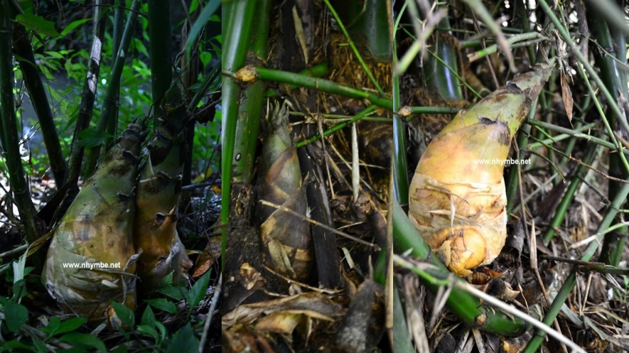
Bamboo shoot

Slide 16
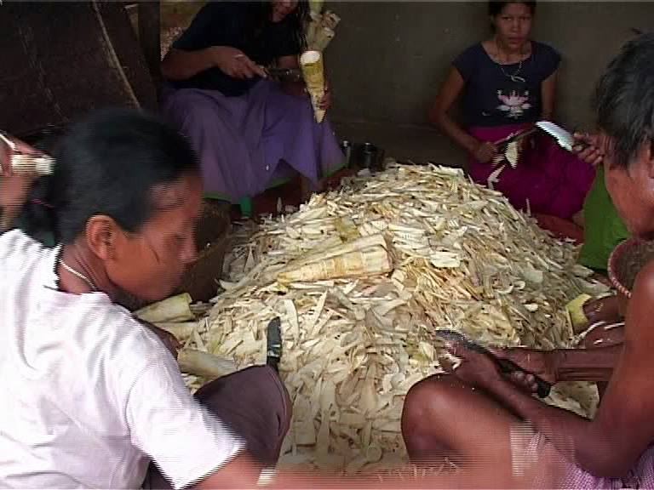
after the collection and slicing

Slide 17
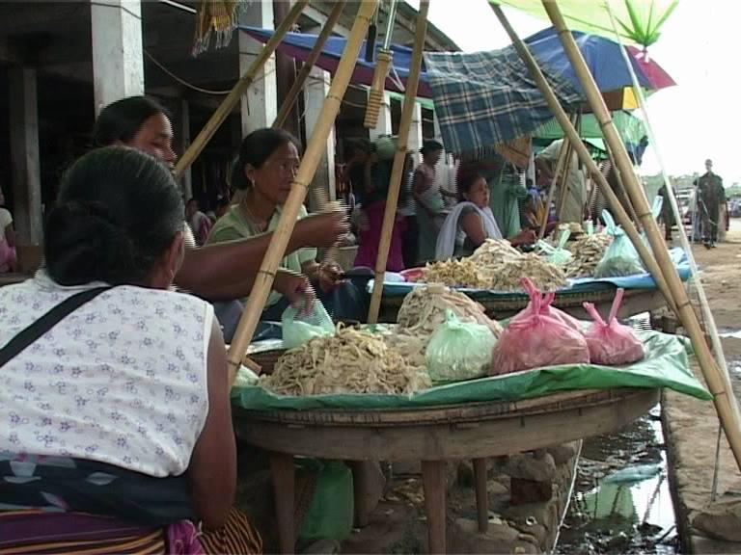
there is no market without selling stock of bamboo shoot all over the year

Slide 18
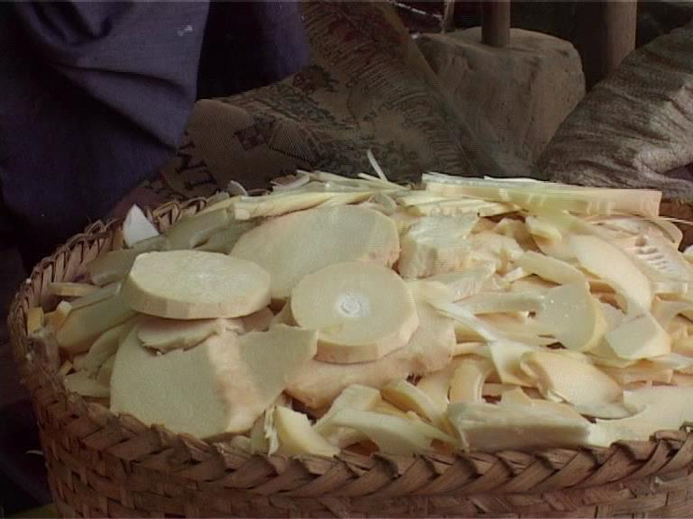
fill the pot or bamboo basket with the slices

Slide 19
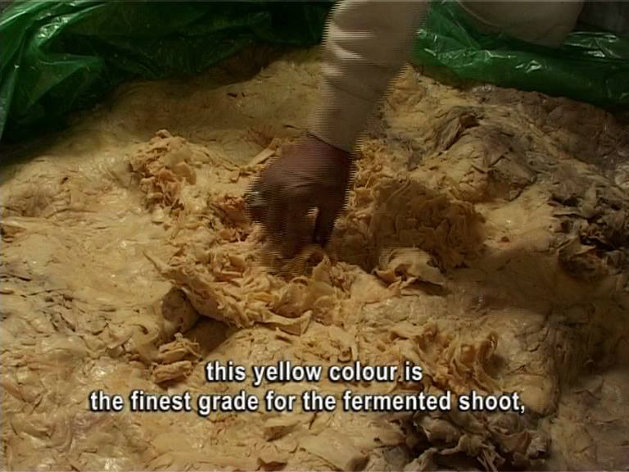
the basket is lined with polythene sheets all around along the wall

Slide 20
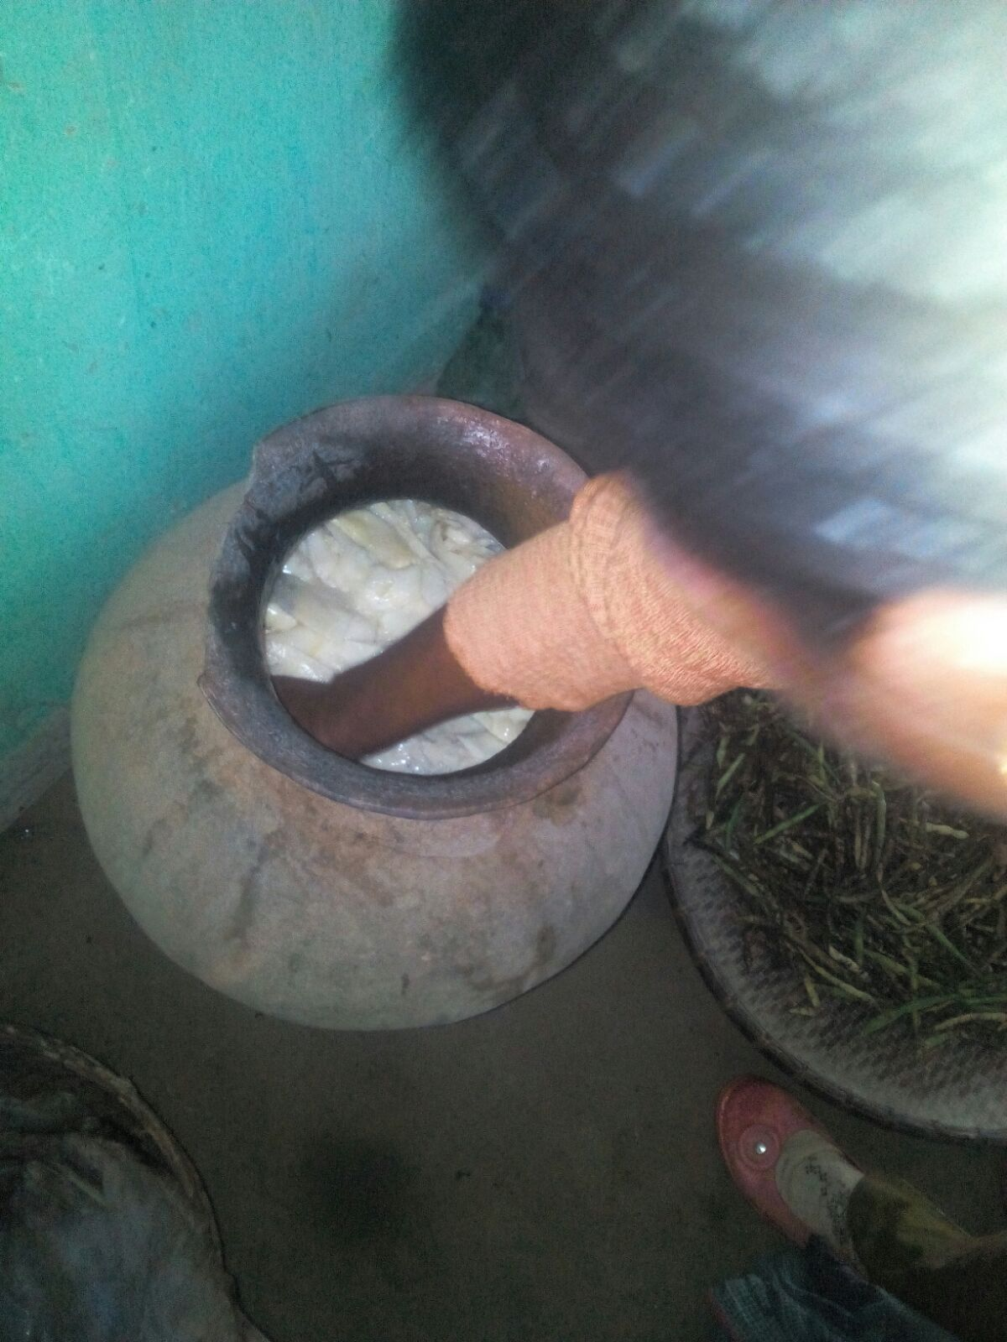
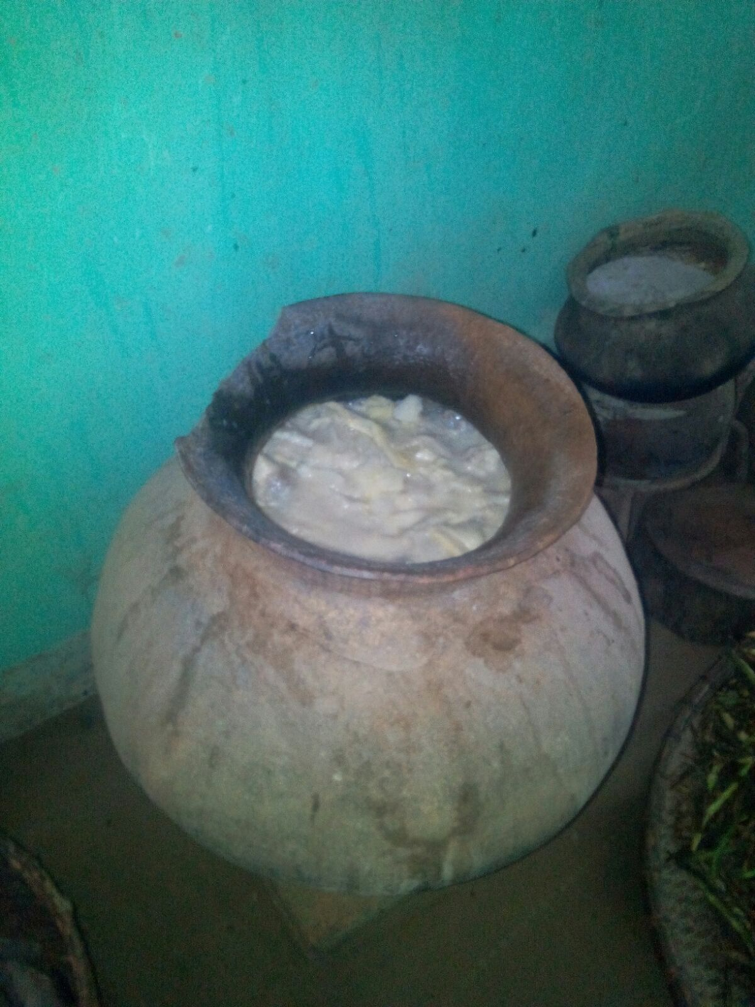
Fermentation for household used Andro Type

Slide 21

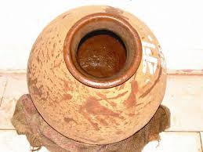

Slide 22
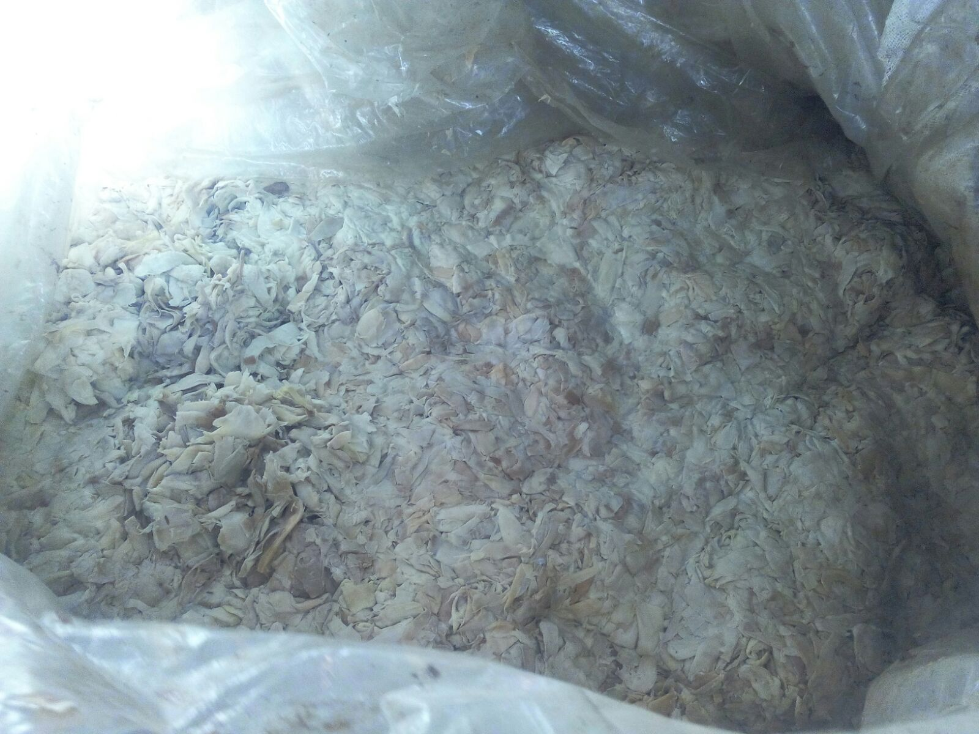
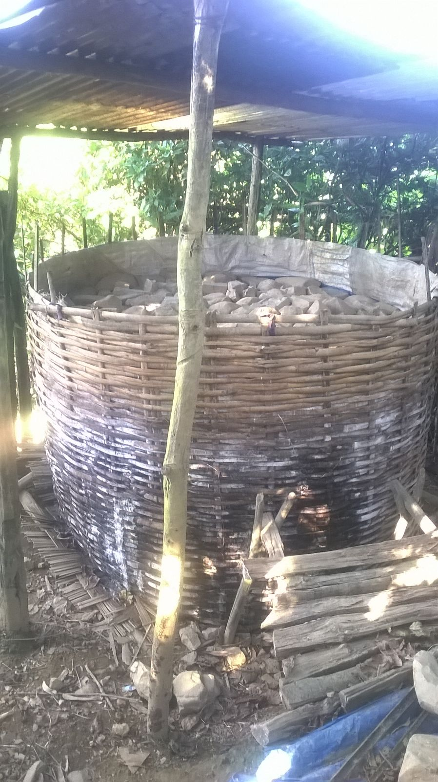
Idea of commercialisation
Nonay Type

Slide 23
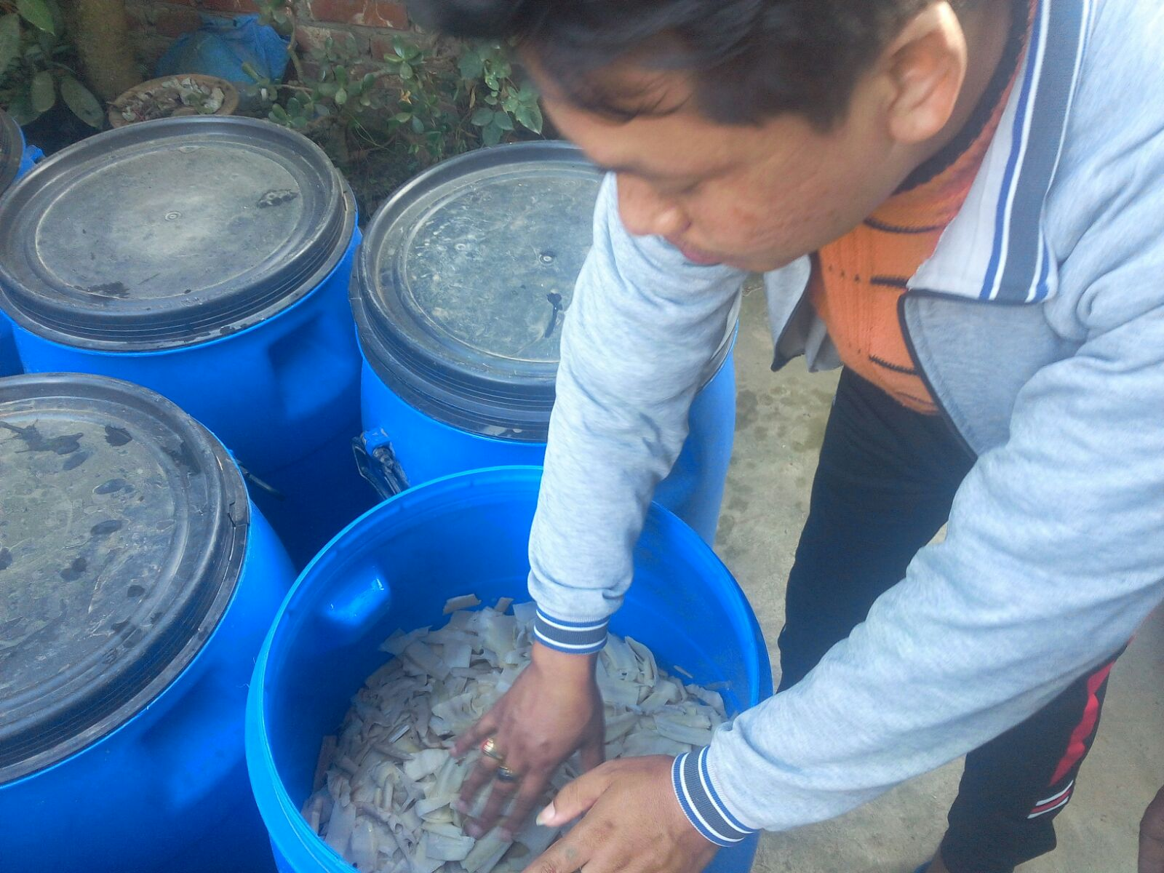
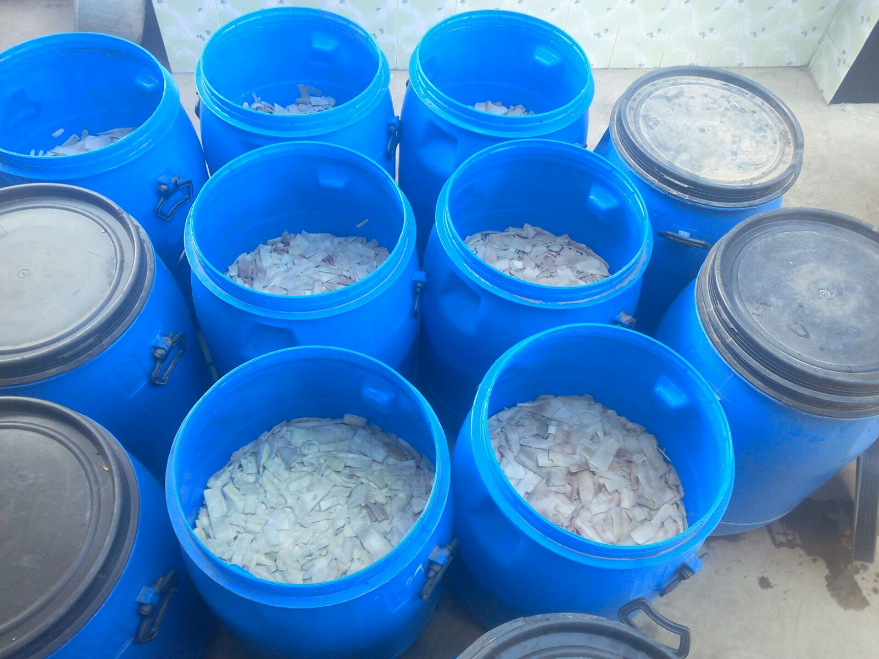
Quick Method
Bishempur Type

Slide 24
Even though fresh and fermented shoots are far superior in taste and texture, bamboo shoots are started available in the canned form.
In the case of Manipur, it started with the development of Meira food processing industry, located at Brahmapur Aribam Leikai (Imphal East), was incorporated in the year 2004.
With many Manipuri’s travelling outside the state, cans of such assorted food are convenient.
The development of innovative product in Meira was another instance of such ‘frugal innovation-process’ in Food processing industry in Manipur.

Slide 25
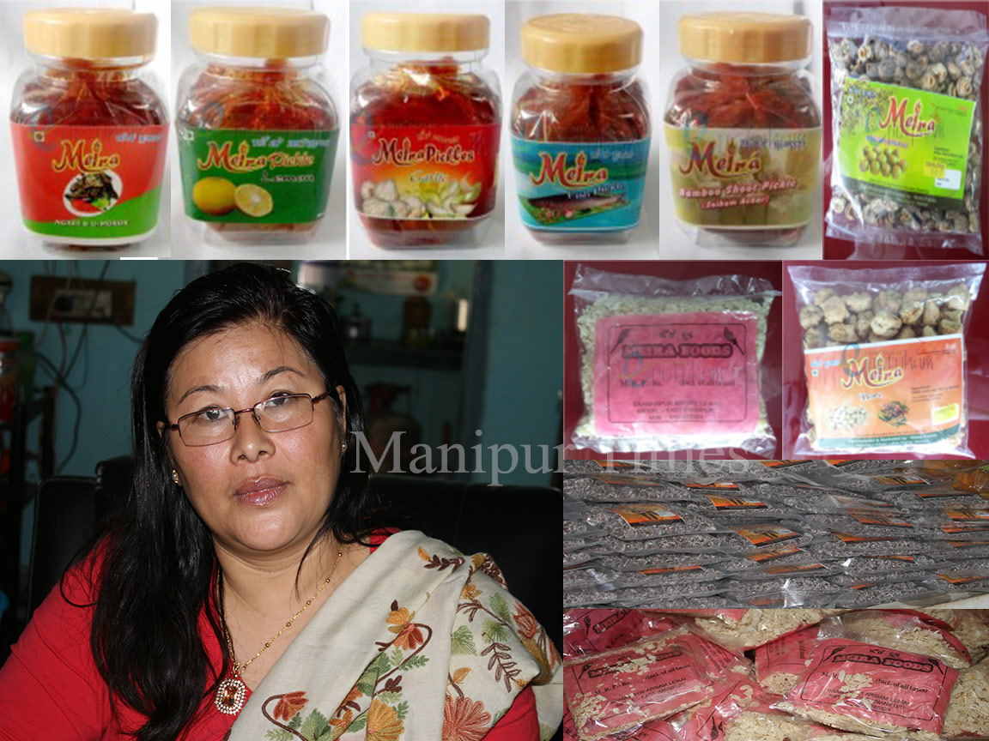
Meira foods- bamboo shoots in pickle form

Slide 26
It also act in some way as a means to preserve their local indigenous food products by taking into different shapes, forms, taste and functionalities.
But innovation never happens in isolation, their activities are embedded in a network of different actors. It was no less local than the pickle, but it was brought forth by other actors with other obligations and interests of many actors.

Slide 27
The idea of frugal innovation in the context of bamboo shoot processing
It is the durable constraints that drive the innovation in the first place (fermentation- Andro type).
In the second place it is the availability constrain that boost the mass production of bamboo shoots. They are using their limited resources in this mass production (Nonay type).
In the third place time become the crucial factor for this innovation (Bishempur type).
In the fourth place because of the convenient bamboo shoot in pickle form started (Bamboo shoot pickle- Meira food).

Slide 28
In the case study, frugal innovation as a prime directive at every stage of bamboo shoot processing.
That results in great value, good quality, functional products that are also affordable to the customer with modest means.
However, such innovation does not explicitly discuss the linkages of diverse actors involved in the innovation process. In this regard, it is wise to look at the ANT perspective for understanding their networks and linkages.

Slide 29
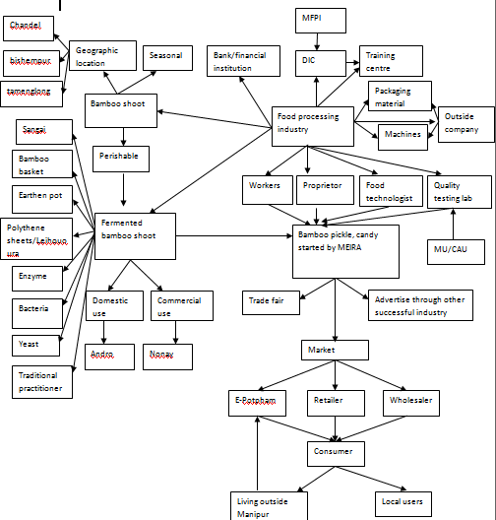
Actor Network in Bamboo Shoot

Slide 30
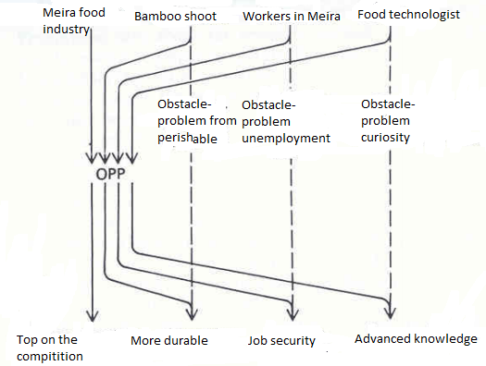
Translation (adopted from Callon, 1986)

Slide 31
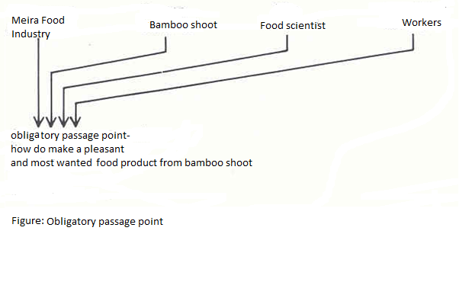
Obligatory passage point (adopted from Callon, 1986)

Slide 32
Conclusion
The analysis of the empirical case study is one of the first kind of attempt to look into frugal innovations in food processing industry of Manipur, India.
Our empirical evidence suggests that frugal innovation at every stage of bamboo shoot processing evolved as a result of resource constrained (more durable, mass production, time factor, and convenient). Thus our research provides empirical evidence that sheds light on how frugal innovation occurs around resource constraint ‘by the poor, for the poor’ innovations.

Slide 33
The paper also attempts to explore the linkages of various actors in the innovation process of bamboo shoot under the umbrella of ANT. ANT helps us to understand better the interaction of human and non- human actors in the process.
This is consistent with the spirit of ANT, which seeks to open up rather than close off a knowledge arena by revisiting taken-for-granted ideas about humans and non-humans in organisations and the changing nature of linkages among them.

Slide 34
Thank you….
Welcome your questions and suggestions….

