Slide 1
An integrative framework linking innovations and value chains
The case of the Kenyan horticulture sector
Aarti Krishnan, University of Manchester, aarti.krishnan-2@manchester.ac.uk
Christopher Foster, University of Sheffield, christopher.foster@sheffield.ac.uk

Slide 2
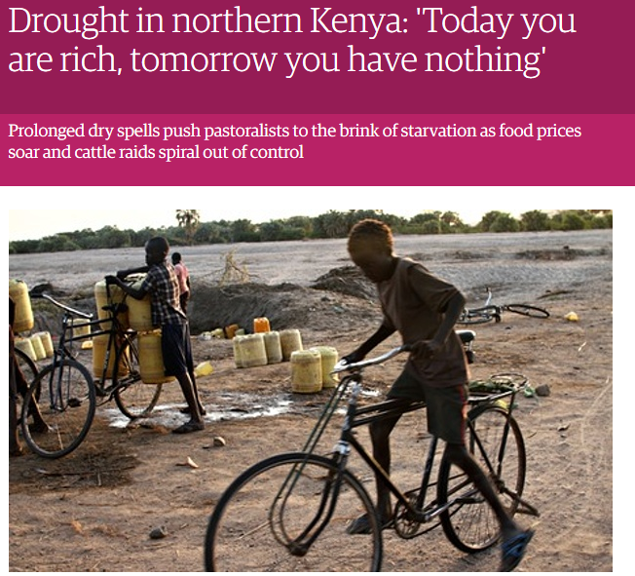
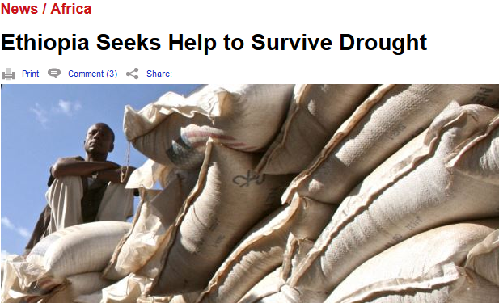
Introduction
Agricultural value chains and climate change
Growing demand for more sustainable practices from value chains
Farmers increasingly effected by weather extremes
=> Climate-based innovation

Slide 3
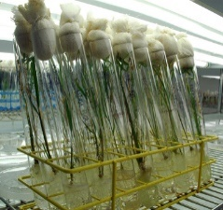
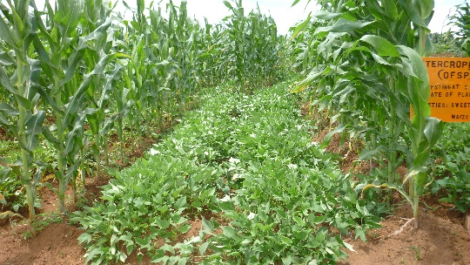
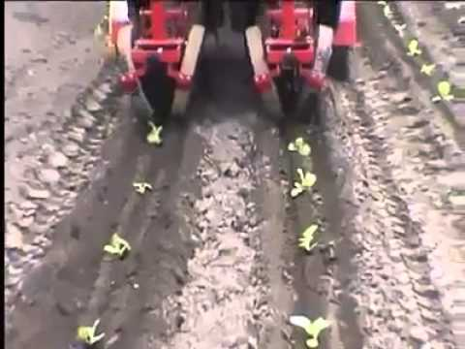
Literature on climate-based innovation
Global value chain literature
Standards/Quality
Innovation – lead firms, standards-driven, formal innovation (upgrading)
Inclusive innovation
Climate adaptations based on local knowledge and farmer networks
Small-scale, frugal innovations
How does the frugality of innovations vary with farmers participating in global and local value chains?

Slide 4
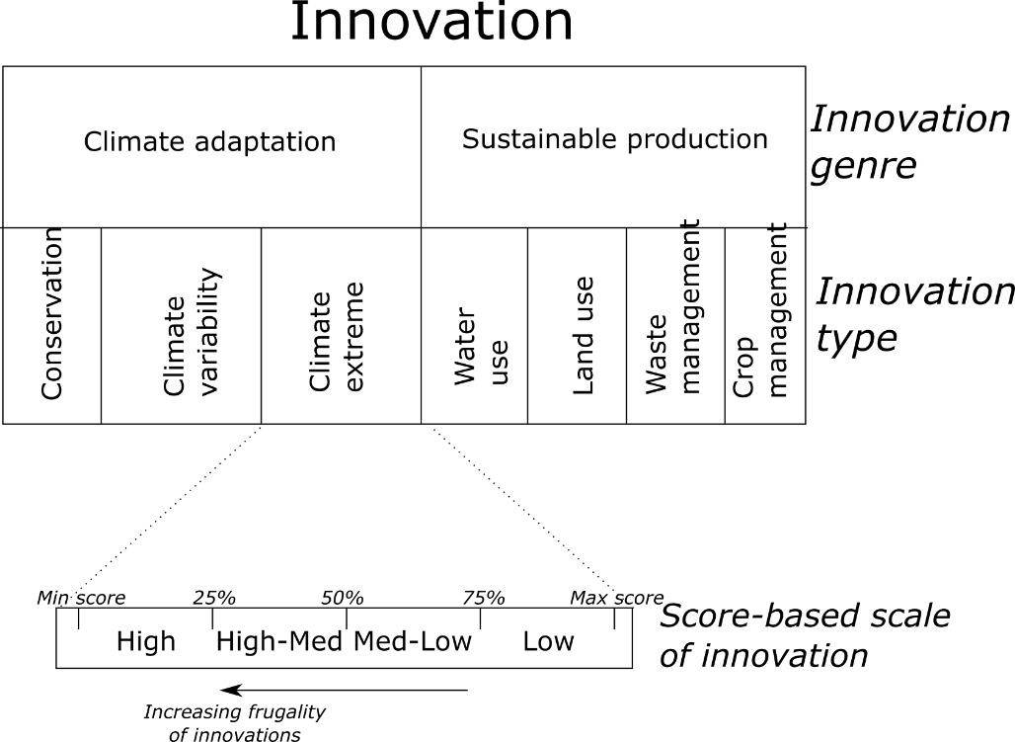
Methodology
How do we measure frugal innovation? (World Bank, 2010; Zanello et al., 2015).
Kenya horticulture (Mango/Avocado)
Survey research on farmer practices
300 farmers in 3 regions
~50/50 GVC and LVC
Variables | Total
Male | 215
Female | 85
Area: Meru | 62
Area:Machakos | 93
Area:Murunga | 145
Education: None | 12
Education: Primary | 124
Education: Secondary | 84
Education: High school | 56
Education: Diploma | 16
Education: Graduate | 8

Slide 5
Innovation Types | % in Complexity Score Quartile for GVC Famers |  |  |  |  | % in Complexity Score Quartile for LVC Famers
 | H | H-M | L-M | L |  | H | H-M | L-M | L
Overall | 18.1 | 23.3 | 22.6 | 36.1 |  | 37.2 | 33.8 | 20.0 | 9.0
Climate Var. | 76.8 | 0.0 | 0.0 | 23.2 |  | 86.2 | 0.0 | 0.0 | 13.8
Climate Extr. | 25.8 | 63.2 | 0.0 | 11.0 |  | 45.1 | 51.0 | 0.0 | 3.4
Conservation | 20.0 | 23.4 | 49.0 | 2.6 |  | 33.7 | 26.2 | 35.9 | 4.1
Climate Adap. | 40.9 | 28.9 | 16.3 | 12.3 |  | 55.0 | 25.8 | 12.0 | 7.1
Crop Mgm. | 26.5 | 45.8 | 0.0 | 27.7 |  | 35.9 | 55.9 | 0.0 | 8.3
Land Use | 45.8 | 0.0 | 47.7 | 6.5 |  | 65.5 | 0.0 | 32.4 | 2.1
Waste Mgm. | 29.0 | 16.8 | 48.4 | 5.8 |  | 64.1 | 15.2 | 19.3 | 1.4
Water Use | 29.0 | 42.6 | 0.0 | 28.4 |  | 55.2 | 26.9 | 0.0 | 17.9
Sust.Prac. | 32.6 | 26.3 | 24.0 | 17.1 |  | 55.2 | 24.5 | 12.9 | 7.4
Farmer innovation score by value chain
General trends
Frugal GVC farmers
Innovative LVC farmers
Policy implications – Frugal innovation and GVC, champion LVC farmers

Slide 6
Variables | Coefficients | Std. Err. | Z | P>z | 95% Conf. Interval
Main buyer | 0.94 | 0.29 | 3.25 | 0.000 | 0.38 | 1.51
Age | -0.01 | 0.01 | -1.18 | 0.240 | -0.03 | 0.01
Sex | 0.47 | 0.28 | 1.68 | 0.090 | -0.08 | 1.03
Alternate activity | 2.05 | 0.42 | 4.84 | 0.000 | 1.22 | 2.88
Education | -0.01 | 0.11 | -0.08 | 0.940 | -0.23 | 0.21
Land size | 0.02 | 0.03 | 0.70 | 0.490 | -0.04 | 0.08
Land ownership | -0.33 | 0.33 | -1.02 | 0.310 | -0.97 | 0.30
Farmer group | 0.56 | 0.27 | 2.04 | 0.040 | 0.02 | 1.09
Internet | -0.56 | 0.36 | -1.55 | 0.120 | -1.26 | 0.15
Machakos | -0.28 | 0.36 | -0.77 | 0.440 | -0.98 | 0.43
Muranga | -1.98 | 0.38 | -5.17 | 0.000 | -2.74 | -1.23
Capacity index | 3.62 | 1.00 | 3.61 | 0.000 | 1.66 | 5.59
Mode of learning
Tacit to mix | 2.03 | 0.80 | 2.53 | 0.010 | 0.46 | 3.60
Mix to explicit | 4.18 | 0.88 | 4.74 | 0.000 | 2.45 | 5.92
/cut1 | 2.86 | 1.09 |  |  | 0.72 | 5.01
/cut2 | 4.95 | 1.12 |  |  | 2.77 | 7.15
/cut3 | 6.81 | 1.14 |  |  | 4.57 | 9.03
LR chi²(14) =254.07, Log likelihood = -286.80398 Prob> chi² =0, Pseudo R² =0.307
Overall innovation determinants
Expected trends – skills, education, location, modes of learning;
Unexpected trends – age, alternative livelihoods

Slide 7
 | Sustainable production |  |  |  | Climate adaptation
 | Quart. land use | Quart Waste Mgmt | Quart water use | Quart Crop mgmt | Quart climate variability | Quart clim. extreme | Quart conservation
Value chain type | 0.584* | 0.627** | 0.411 | 0.445 | 0.616 | 0.232 | 0.0144
Age | -0.00405 | -0.00521 | -0.0202** | 0.00648 | 0.00729 | -0.0148 | 0.00566
Sex | 0.342 | 0.0868 | 0.0408 | 0.457 | 0.143 | -0.0234 | -0.381
Alternate activity in lean season | 0.171 | 0.855** | -0.406 | -0.332 | 0.294 | 0.0653 | 0.381
Education | 0.0793 | 0.0545 | -0.0395 | -0.0238 | 0.106 | -0.0315 | -0.0599
Land size | 0.00323 | 0.00854 | -0.00252 | 0.00989 | 0.0200 | -0.000157 | 0.00357
Land ownership | -0.398** | -0.104 | 0.116 | -0.660* | -0.0556 | -0.178 | -0.124
Part of farmer group | 0.468 | -0.0139 | -0.106 | 0.653** | 0.123 | 0.447 | 0.280
Internet | -0.549 | 1.005*** | 0.0153 | -1.039** | -0.901* | 0.631 | -0.472
Machakos | -0.695** | -0.505 | -2.010*** | -1.240*** | -0.246 | 0.634* | 1.515***
Muranga | -1.852*** | 0.893** | -2.781*** | -3.534*** | -0.746* | -0.175 | 1.024***
Physical productive index | 0.585 | 0.400 | 2.474** | 4.546*** | 0.972 | 1.364 | 1.253
2.mode of learning | 0.886 | 16.08 | 2.042* | 2.547** | 0.0346 | 1.348** | 1.666***
3.mode of learning | 2.218** | 18.09 | 3.633*** | 2.555** | 0.264 | 2.367*** | 2.480***
Innovation types
Innovation genres
Policy implications
Climate adaptation vs sustainable production
How might climate-based innovation be guided

Slide 8
Results 3
Modes of learning
Causality – Feedback effects
Policy implications
Climate-innovation likely to be diffuse and adapted
Similarity in determinants – innovation and value chains
Dependent: VC type | Coef. | Std. Err | z | P>z | 95% confidence interval
Total innovation score | 0.083 | 0.0250 | 3.32 | 0.001 | 0.0340 | 0.132
Capacity index | 1.511 | 0.5620 | 2.69 | 0.007 | 0.409 | 2.6127
Land size | -0.007 | 0.005 | -1.4 | 0.162 | -0.016 | 0.0026
Education | -0.333 | 0.270 | -1.23 | 0.217 | -0.863 | 0.1964
Meru | -0.922 | 0.265 | -3.48 | 0.000 | -1.441 | -0.403
Machakos | -0.950 | 0.241 | -3.95 | 0.000 | -1.423 | -0.478
Age*education | 0.0051 | 0.005 | 1 | 0.316 | -0.0049 | 0.0151
Age | -0.0155 | 0.016 | -0.98 | 0.325 | -0.0466 | 0.015
Land ownership | -0.258 | 0.250 | -1.03 | 0.302 | -0.7488 | 0.232
Farmer group | 0.817 | 0.186 | 4.4 | 0.000 | 0.4528 | 1.181
Md of learning
-Tacit to Mixed | 0.2037 | 0.447 | 0.45 | 0.649 | -0.67425 | 1.081
- Mix to explicit | 0.9296 | 0.547 | 1.7 | 0.09 | -0.14411 | 2.003

Slide 9
Conclusions
Integration between innovation and value chains
Methodology
Innovation types, innovation genres
Score-based scales allow us to explore varying complexity of innovations
How might such approaches be used more widely to explore frugal innovation

Slide 10
Conclusions
Frugality – it’s not just for lower value LVC farmers
A crucial element of GVC and climate adaptation
LVC and climate innovation
Local market farmers sometimes more innovative
Innovations types are not all the same
Different genres
How that should effect how they are treated?

