Slide 1
Exploring the Policy Space for Frugal Innovations in the Global South
Saradindu Bhaduri
Prince Claus Chair in Development and Equity (2015-17)
Centre for Frugal Innovation in Africa
ISS, The Hague
&
Centre for Studies in Science Policy
Jawaharlal Nehru University, New Delhi

Slide 2
Presentation plan
Frugal Innovations:
    Context and Concept
      Examples and Characteristics
Policy approaches to frugal innovations: an overview of the existing scenario.
The policy space for “frugal innovations” within the WTO framework.
Some thoughts on future directions.

Slide 3
Frugal Innovations: the context
Development orientation of Innovation literature since the 1980s.
    Technological capability/ -> Incremental Innovations
      (Sanjaya Lall, Richard Nelson, Nathan Rosenberg)
    AND ‘liberalisation’ of the term “innovation” in the last decade embracing ‘pluralism’ in innovative activities.
    Inclusive Innovation/ Grassroots innovations/Frugal innovations
  Are these compartments watertight?

Slide 4
Frugal Innovations: the concept
      Definitional issues and ambiguities
        How? For whom? By whom?
    While there is a consensus that such innovations must cater to the developmental requirements/needs of “marginal groups”/vulnerable sections or people at the “bottom of the pyramid”, not much unanimity on “who the innovators are?”
      State agencies/development organisations/academic institutions/large business firms.

Slide 5
Frugal Innovations: the concept
The focus of the current presentation is on “people innovating for themselves (and, may be for others too!)”
    Offers insights into the knowledge dynamics at the BoP
    Highlights the role of human agency at the BoP
    AND, such innovations in my view suitably relate to the notion of ‘frugality’…!

Slide 6
Conceptualising Frugality
A Search process using simple hierarchical steps and intuitive reasoning (rather than clearly defined rule based maximisation)
Efforts to adapt to the environmental challenges through demonstrated capacity of learning, and imitation.
Emphasis on actual performances/practicability/effectiveness rather than logical/scientific validation

Slide 7
Frugal Innovations: examples
Examples of Frugal Innovations:
    Jua kali (Daniels 2010), informal furniture business in Nairobi (Harris 2014)
    Threshers by farmers in Zimbabwe (Manyati 2014)
    ‘Grassroots innovators’ in India scouted by the NIF takes a broader view and include innovations done by individuals with or without a business motive.

Slide 8
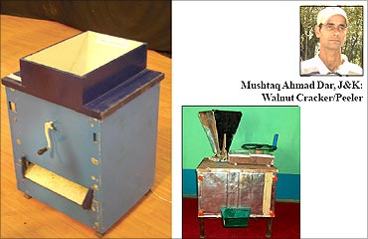
Walnut PROCESSING UNIT
Characteristics
Innovations Initiated to address health hazards related to walnut cracking and washing.
Close relational transaction with local mechanics
Initially, free distribution in the locality, to get feedback
Eventually, taken Indian patents with a firm.
Patent and relational contract!

Slide 9
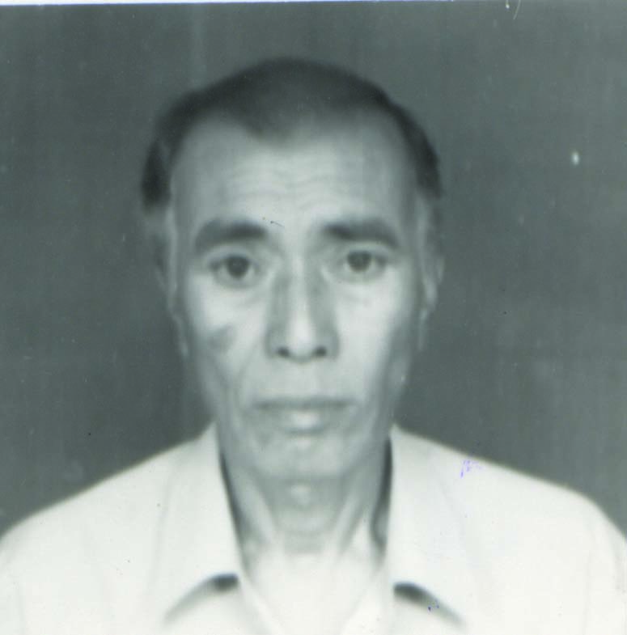
Frugal Innovations: examples
Closed wood pyre
Characteristics
Kambel Chulai is a class III drop out.
Responds to problem of heavy rainfall and deforestation, in the absence of regular electricity supply
Installation cost 50% of electric crematorium
cremation cost 10% of electric cremation
Accepted by local religious organisation

Slide 10
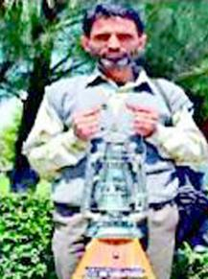
Frugal Innovations: examples
Singing lantern
Characteristics
Ghulam Mohammad Mir
To maintain a particular behavior in a changed social context.
Wants to develop a business around it

Slide 11
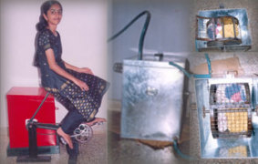
Frugal Innovations: examples
Washing cum exercise machine
Characteristics
Remya Jose was class XI student when she developed it to respond to frequent power cut.
Her approach to uncertainty:
“Whatever you have in mind, try it. Don’t worry about making mistakes, they can surely be corrected.”

Slide 12
Frugal Innovations: characteristics
(a) as observed by researchers
    Diverse, and shifting, motivations (pro-social to pro-market)
    No clear budgetary allocation
    No clear timeline/concept of failure
    Reliance on non-codified body of knowledge
    Diverse modes of implementation of innovations
    Strongly embedded to local situations (knowledge, raw materials, applicability)

Slide 13
Frugal innovations: characteristics
(b) as observed by scientists (well, ma not be all, but majority of them)
    It’s a trash!
    Very crude design!
    Hm…they seem to work in the field, but not in the lab, for sure!
  (c) as seen by policy makers
    Ranges from
      seeing it as “corrupt way of looking at innovation” by chief policy advisor to science and technology to PM….to
      Awarding President’s award to grassroots innovators every year!

Slide 14
Policy approach and framework: the existing scenario
In India, the Science Technology Innovation Policy 2013 is silent about such innovations.
But there exists policies for ‘skill development’, ‘training’ and ‘incubation’ (ex-situ)
    Defining ‘skills’ is often problematic …Basola (2014)
    Often follows a ‘deficit model’ understanding: Local knowledge is undermined in policy science!
National Innovation Foundation attempts to ‘encourage’, ‘award’, help ‘scale up’, and file patents for grassroots innovators, with limited success.
  Often attempts to formalise such innovations with thrust on IPR, ‘scale up’ and collaborations with R&D institutes and formal sector firms (once again, ex-situ)
  However, NIF has been doing marvellous work in scouting innovators and trying to develop a pressure group in policy making exercises.
    Compared to STN (Brazil) NIF’s network looks fragile!
Recently, a ‘Bank of Ideas and Innovation’ has been set up with 3 Ministries.

Slide 15
Policy approach and framework: the existing scenario
Social Technology Network in Brazil (estd 2004) to facilitate process of social inclusion, public participation and income generation based on science and technology. STN has set up a bank of Social Technologies.
    Issues of power and local knowledge
In Bangladesh, BRAC experiments with use of mobile phone in micro financing. But no policy seems to exist.
Diverse policy attention in Africa to innovations in informal economy: Kenya and Nigeria have articulated the need to integrate informal sector in innovation policies.
A WIPO group of researchers is working on articulating informal sector innovation policies for Africa.
    Public procurement has been emphasised upon.
  Existing policy framework everywhere emphasises on economic aspects.

Slide 16
The available policy space for governments in the global South under WTO
Policy space under WTO
    IPR framework: no scope for utility patents.
    Product standards and regulation
    Fiscal discipline (fund cuts to public funded research)
    Competitiveness for Banks
    Thrust on Exports
    Market distortion (implications for procurement policy)
  Space for manoeuvring:
      R&D and technology
      Social/cultural sector

Slide 17
Some thoughts for policymaking
Acknowledge frugal innovation as knowledge generating activity of a specific kind.
  Frascati manual: R&D is …”any creative work in a systematic manner, and use of knowledge to devise applications”.
    Need in-situ knowledge ‘exchange’: creation/reorientation of ‘extension centres’ linked to public institutions
    Barefoot college in India could be a model for improvisations!
  Governmental interventions can be made part of poverty alleviation programmes to support non-entrepreneurial (pro-social) frugal innovations.
  Use Corporate Social Responsibility to support innovative activities.
    Currently they mostly spend money for beautification of neighbourhood parks!
  Link frugal innovations with ‘culture’ and ‘tradition’
    Less rigid adherence to ‘standards’ and ‘quality’
    More acceptability at the local level

Slide 18
Thank you….

